Slide 1
Web Scraping for Fun and Profit
Win Suen
Girls Who Code
July 17, 2018

Slide 2
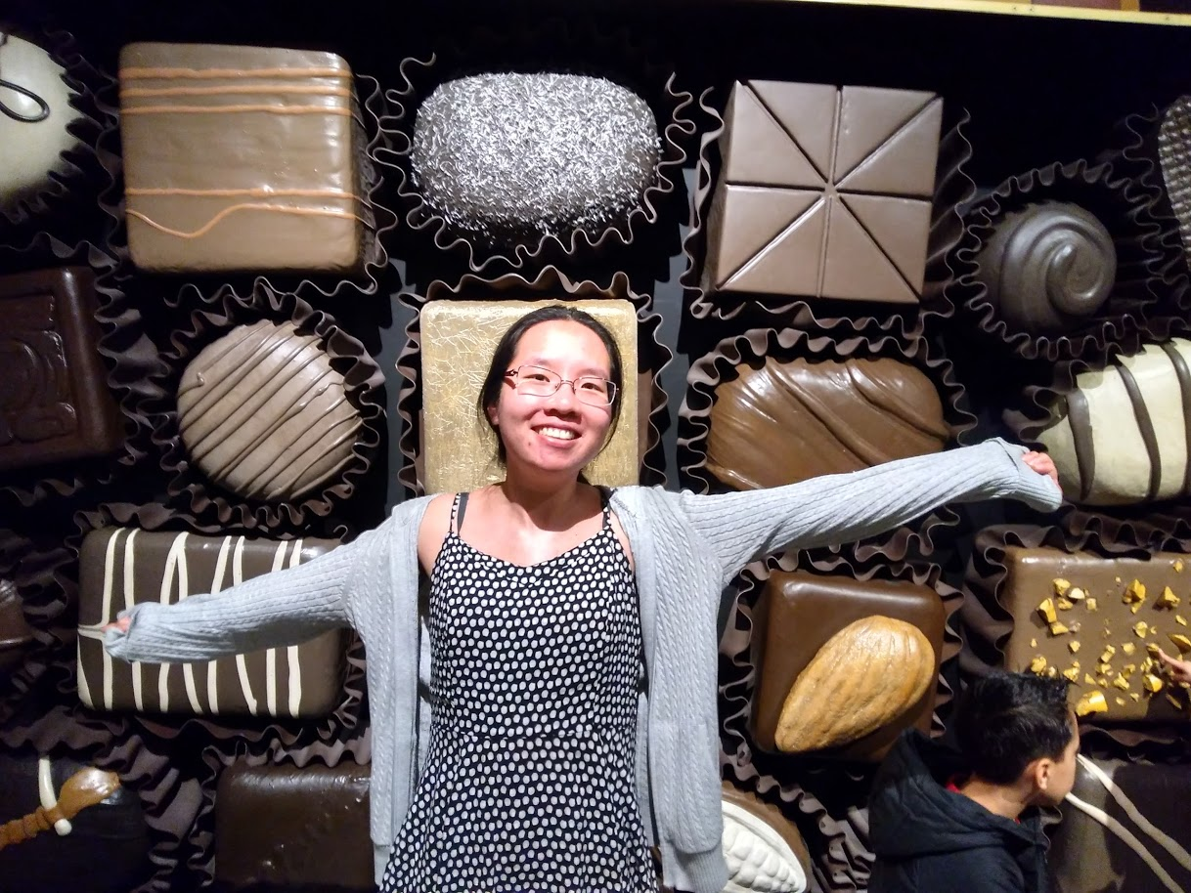
Hello!
I am Win Suen
I’m a Data Scientist at AppNexus.
Likes: Hiking, chocolate, and fighting fraud.

Slide 3
What do you do all day?
Make hypothesis.
Find lots of data.
Munge lots of data.
Test hypothesis.
Rinse and repeat.

Slide 4

What do you do all day?
Make hypothesis.
Find lots of data.
Munge lots of data.
Test hypothesis.
Rinse and repeat.
This is where web scraping can be a powerful tool.

Slide 5
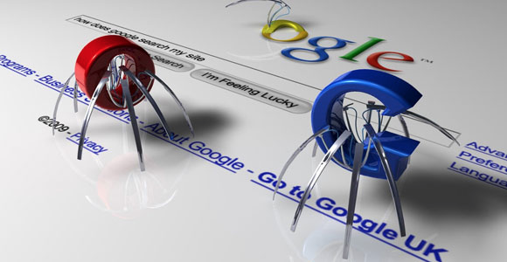
What is web scraping?
Getting content off the Internet programmatically.
Has many useful and fun applications.
Used by many organizations to get content off Internet.

Slide 6
An analogy

Slide 7




Browsers: how humans access information on the web

Slide 8

Your browser is like a television.

Slide 9
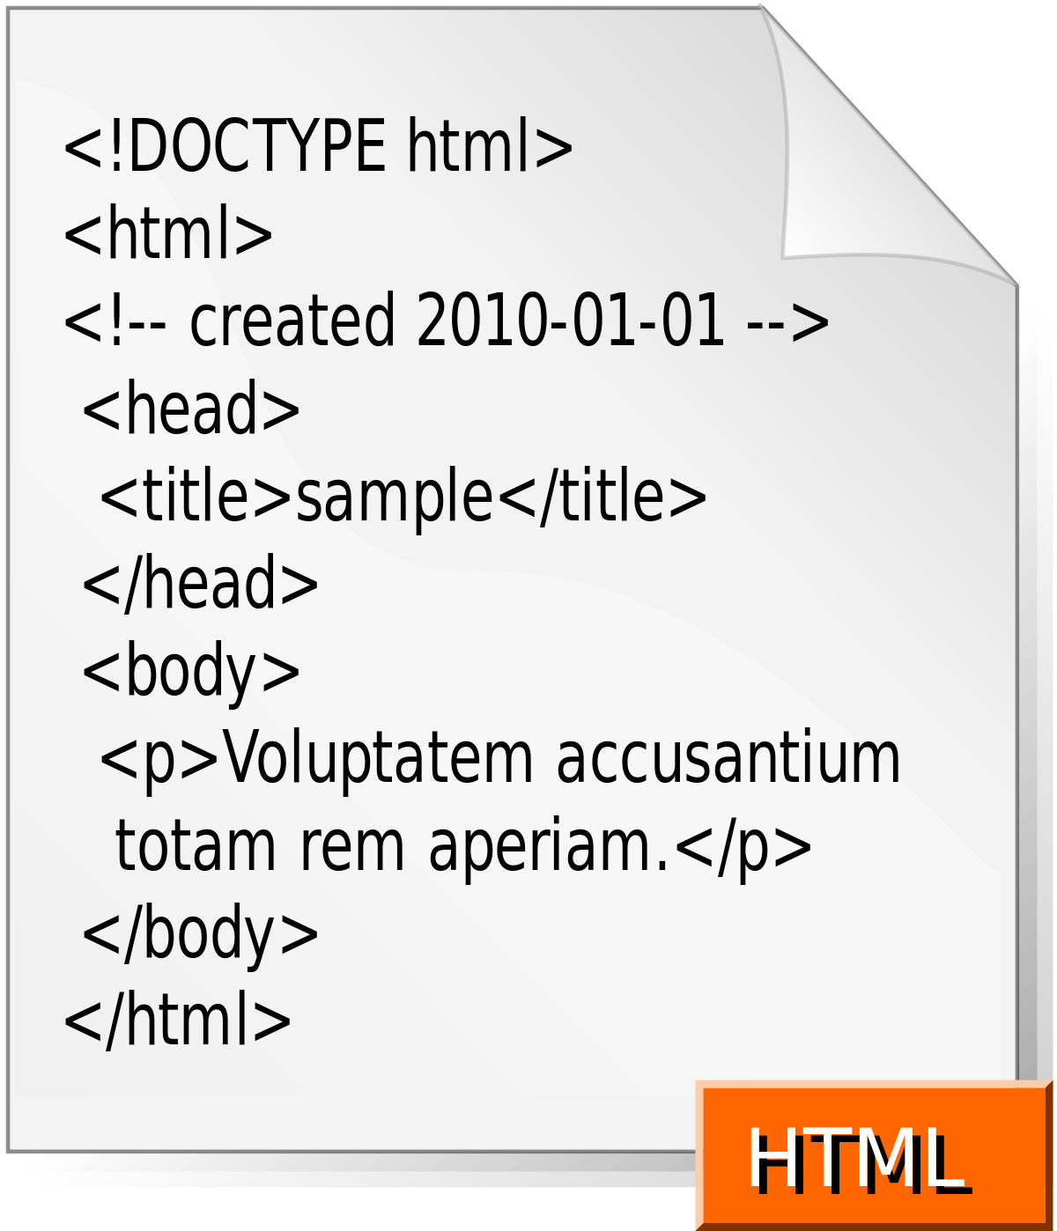
Your browser is like a television.
Input

Slide 10
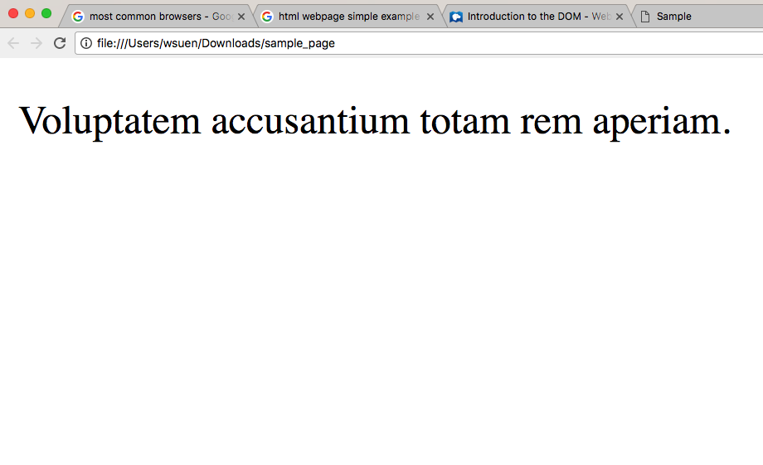
Your browser is like a television.
Voila!
Input

Slide 11
Cat break

Slide 12
How does my browser get content?

Slide 13
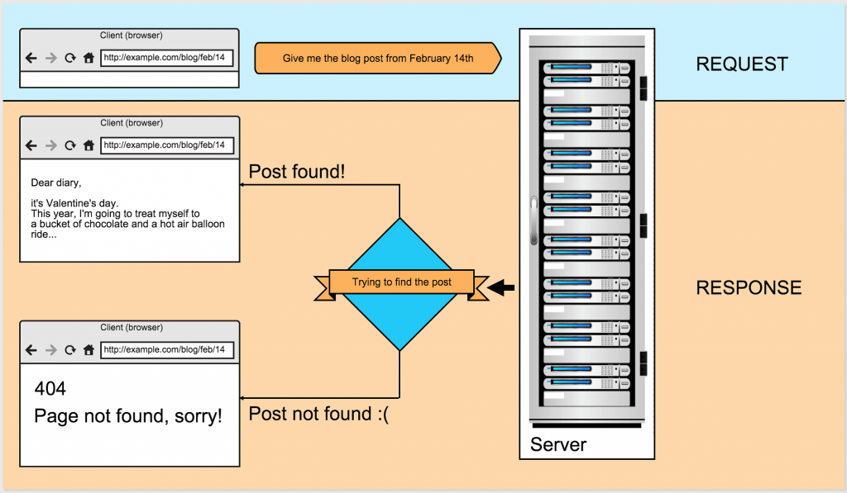
Image credit: https://hostadvice.com/blog/anatomy-web-requests-php-perspective/

Slide 14
Code!

Slide 15

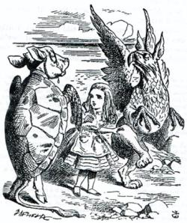
Your toolkit
Requests
Beautiful Soup

Slide 16
To the notebook! And kittens!

Slide 17
A funny story

Slide 18
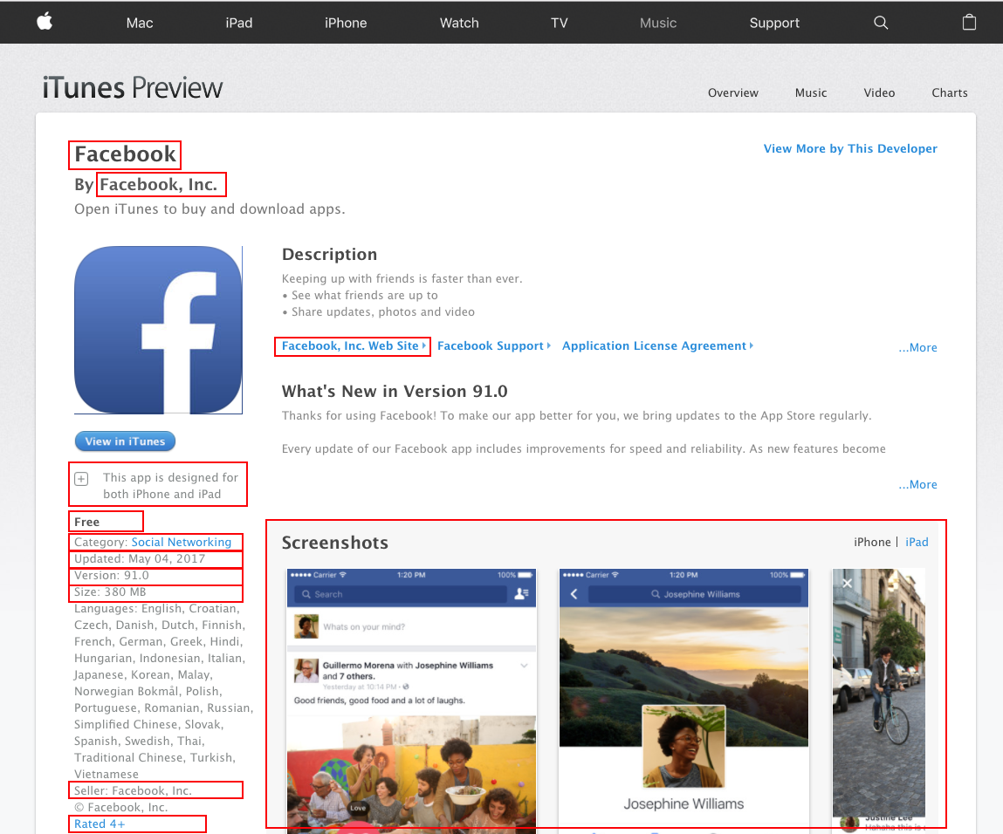
For hundreds of thousands
of apps!

Slide 19
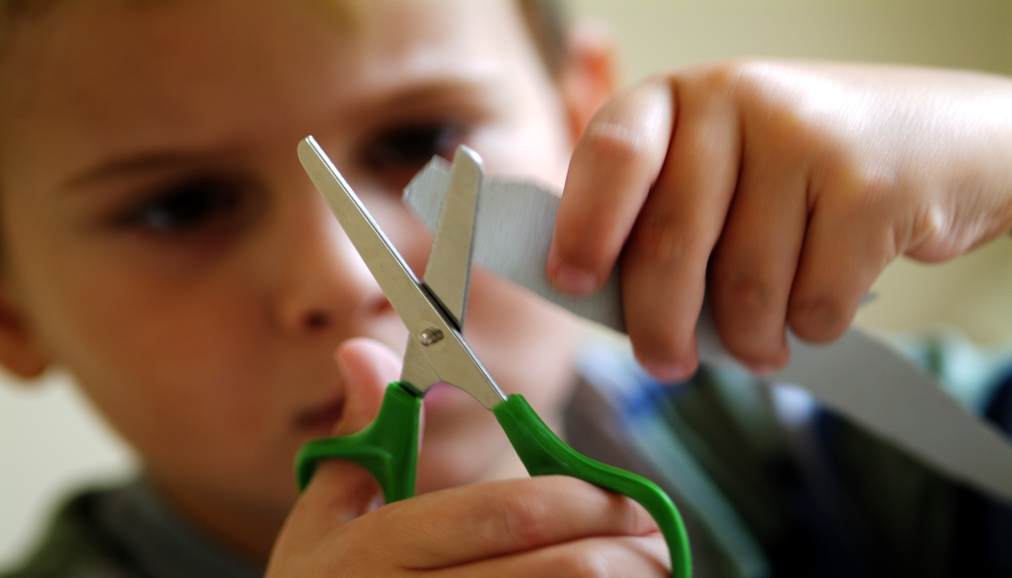
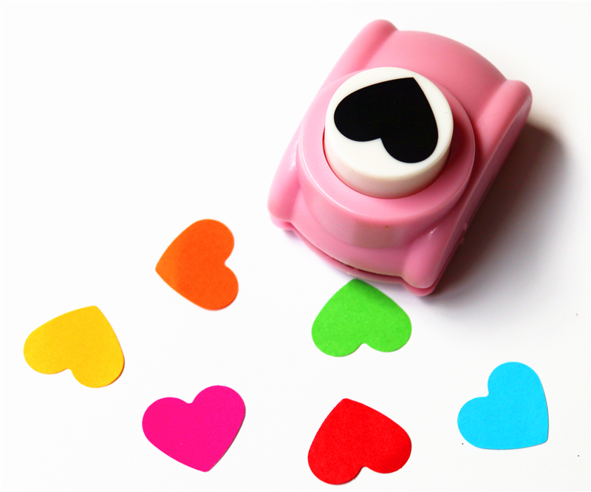
What I was trying to do
The existing solution (API)

Slide 20
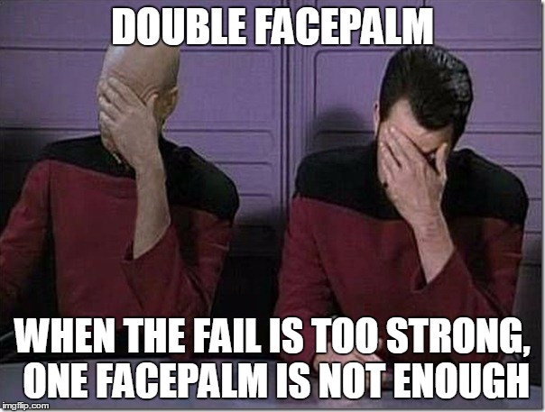

Slide 21
Thanks!
Any questions?
Find me at:
wsuen@appnexus.com
wsuen on Github.

